Slide 1

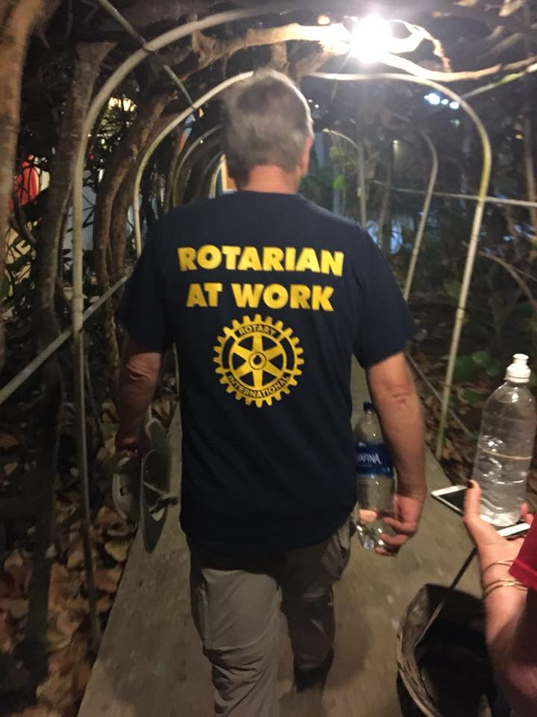
Rotary Club of Brevard
New member Introduction
Impacting and Improving the Community

Slide 2

Thought from Rotary!

Slide 3
Welcome to Rotary International
Begun in Chicago in 1905 – 116 years old.
1.2 million members in 32K clubs across the world – as a member you can attend any meeting anywhere in the world.
Rotary is split into Regions, Zones, Districts and then Clubs
We belong to Rotary district 7670 which comprises around 50 clubs in WNC – some large like Asheville; some small/medium like Brevard. We won the best small club award in 2020.
Ken Shull is DG. Our “year” runs July 1 to June 30 – Richard takes over from me – in six months!
All clubs are individual and work on their own projects – have their own boards and often their own local foundation.our foundation is called the John Scarlett Foundation, which is our 501c3
We are not affiliated politically or religiously. We are simply a reflection of the community – diversity. Not just old white guys!
50/50 after this induction
RI has its own Foundation – Renown for its work on Polio eradication; Peace scholars and international exchange and grants
All clubs are taking their own path – Networking (traditional); and community Impact clubs - satellites – Rosman in 2026.
We share certain education, program and financial/insurance/grants/pooling grants/international grants with RI

Slide 4
A history of our Club
76 years old – 1947
Club has grown to over 70 members – then declined -
Spun off The Pisgah Forest club - They in turn have spun off a satellite club at Cedar Mountain
Projects over the years …. Scholarships.
Starting to grow again based around “community Impact”
Future is bright

Slide 5
Welcome to the Rotary Club of Brevard, today
A community impact club – less focus on networking, though that is a benefit
Today we have 50 members –Jan 1 - began the year at 43.
One of the fastest growing club among the 50 clubs in WNC
We currently meet on a Tuesday at Noon – but if we have an event or activity in the week, we will cancel the meeting itself
We focus on schools (multiple projects there); COVID and Health; Homelessness; Polio and Alzheimers through Rotary itself; Elves (has spun off); and other causes in the County.
We are flexible in our approach – we can be the amplification of your passion to improve a community, or we can work across the entire spectrum of projects.
Fundraise using the 5K races as our cash generator – we really need a second.
Our Motto is “if not us, then who?”

Slide 6
What benefits do you derive
You become a member of:
An internationally recognized organization – go to any meeting, anytime
A locally recognized community IMPACT organization
Either follow your own community improvement endeavor and/or
Assist with many across the community and Leverage the clubs and RI’s resources
A feeling that in a small/large way that you are improving the community, the country and the world, and directly yourself.

Slide 7
What did we have done – Children and Health
The TenTwentySix Youth Hub
The Magic book bus – creative classroom program TCSEF
El Centro soccer field – just opened
The three 5K races
The MOAI’s each week – Blue Zones project
Sharing house blankets and Coats – as well as crisis grants
Cancer research – youth (St Baldricks)
Handing out grants – few
Supporting other organizations
Overseas exchanges and the RYLA program
DEPOT support as general start for programs

Slide 8
What did we do – Seniors and Covid
We have the Polio and CART (Coins for Alzheimers research trust) programs http://www.cartfund.org/cart/donations/
Salvation army – ringing the bell (need ringers!) and sponsor
United Way transition project – Interim 3 months funded – Volunteer Transylvania – monthly roundtable (Thursday)
The Covid PPE emergency supply.
The Elves – Cards and presents - Televisions for the clients at the Care Homes – moved on.

Slide 9
What is new
A new Youth Hub for Rosman – a million dollar project
12-15 creative classroom projects - we will add challenge grants –
Adopt a Classroom
RYSC – grant of computer equipment – not security equipment!
Support other organizations
More diversity in the club to better reflect the community we service
“Friends”
Virtual group of members – ready to help online
I keep wondering how we help in disasters
We look for areas/projects that need attention/help – that no one else is addressing – agile and quick to respond – the “if not us then who” question - Not just free labor

Slide 10
A few more …
The holiday parade
Pumpkinfest
Blood drive
Chamber mtgs
Corn hole
TVS
Ecusta
Reading and the book bus
Trash pickup - 2
Haiti - $
Family place – project
Honor flight – this year
Volunteer Transylvania
Rise and Shine
Shoes
Fun – low country boil and QTR socials

Slide 11
What am I required to do?
What does membership cost:
Pay $300 for the six months in 2026
That does not change for July 1, 2026, to June 30, 2027.
We ask you for a small donation to the POLIO and RI Foundation, if you can!
You pay for any food or drink at in person meetings that you attend
What events do I have to attend (if you can):
We ask that you help on the 3 race mornings; other events – again if you can
As many other projects and events, as possible – trash pickup is heavy on personnel
As many virtual meetings
But family and work come first and second – we understand

Slide 12
So where do we go in 2026
Local community thrust
More ‘engaged’ members
Keep rebooting the Races …
We need another alternate revenue stream-
Focus on Schools, TenTwentySix Youth Hub & Other programs but also on issues – we are not shy of taking on the difficult stuff ..and taking heat.
Mix of in person and virtual meetings.
“A real impact in the community”

Slide 13
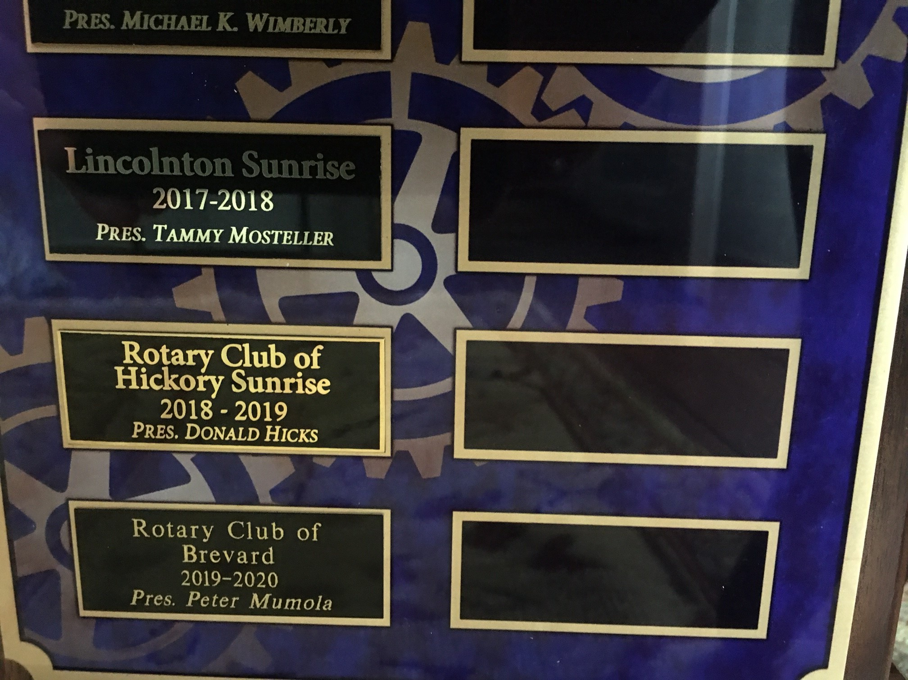
Best club award - More info
  Follow the Club Facebook page
  Read over the Web site www.brevardrotary.org
  Read over the Rotary web site www.rotary.org
  I will give you log-in details – all the lights wil go on in mid January when I register you ☺

Slide 14

What’s next?
How do I join the “Best Club” in WNC?
Contact Mike Dexter-Smith on brevardrotarync@gmail.com or 508-395-0224
And come and help us make our Community an even better place.

